Slide 1
Functional Organisation of Skeletal Muscle
Date: 01-11-2025
Dr. Yerra Vishnu Akhil Raj Kumar
Senior Resident, AIIMS Bibinagar
MBBS- AIIMS Patna
Bio-Design Fellow- IIT Hyderabad
MD Physiology- AIIMS Raipur

Slide 2
Contents
Case Scenario
History
Main Topic-1
Main Topic-2
Recent Advances

Slide 3
Case Scenario

Slide 4
History
A 7-year-old boy is brought by his parents with complaints of progressive difficulty in climbing stairs and rising from the floor. The child walks with a waddling gait and often falls while running. Parents noticed that he uses his hands to push himself upright from a squatting position (Gower’s sign positive).
No sensory loss, no sphincter disturbance. Antenatal and birth history normal. No history of perinatal asphyxia.
Family history: maternal uncle with similar symptoms in childhood.

Slide 5
Investigations
Serum CPK: ↑↑ (10× normal)
EMG: Myopathic pattern (small, polyphasic potentials)
Muscle biopsy: Degenerating fibers, fibrosis, fat infiltration
Genetic testing: Dystrophin gene deletion on Xp21

Slide 6
Examination
General: Alert, thin upper limbs with bulky calves (pseudohypertrophy).
Gait: Waddling.
Posture: Lumbar lordosis.
Muscle power: Proximal > distal weakness (especially hip and shoulder girdles).
Tone: Mildly decreased.
Reflexes: Diminished deep tendon reflexes in lower limbs.
Sensory: Intact.
Other systems: Normal.

Slide 7
Explain the normal role of dystrophin in maintaining muscle fiber integrity.
Describe the sarcomere zones (A-band, I-band, H-zone, M-line, Z-line) and explain what happens to each during contraction.
What is the physiological rationale behind steroid therapy and gene-editing approaches in DMD?

Slide 8
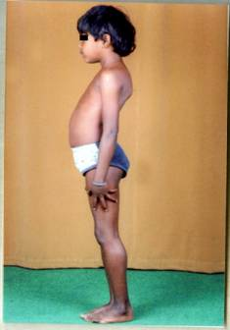

Slide 9
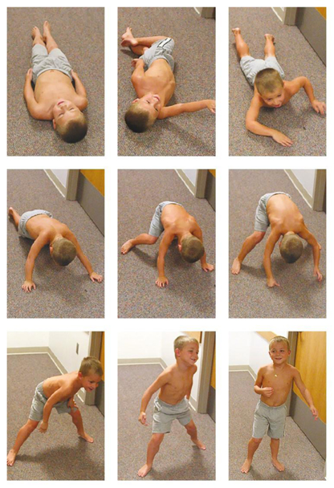
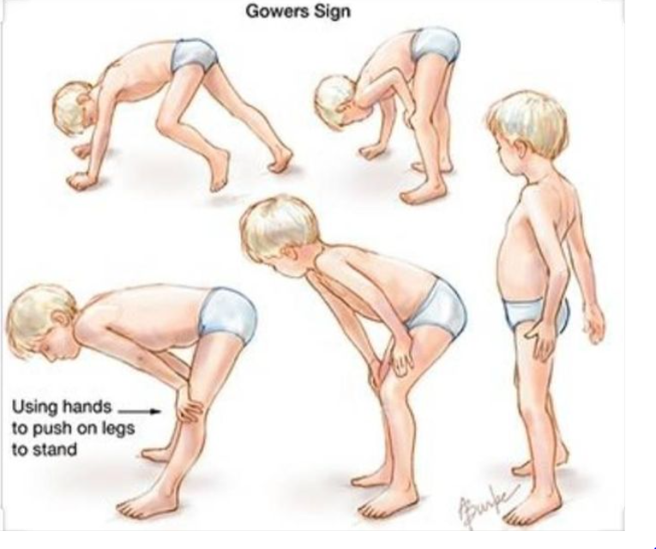

Slide 10
History

Slide 11
Wilhelm Kühne (1880s): First isolated myosin, introducing the concept of contractile proteins in muscle.
Andrew F. Huxley & Hugh Huxley (1954): Proposed the Sliding Filament Theory, explaining sarcomere shortening by actin–myosin interaction.
Kendrick and Offer (1970s): Discovered titin and nebulin, giant proteins maintaining elasticity and filament alignment.
Louis Kunkel (1987): Identified the dystrophin gene mutation as the cause of Duchenne Muscular Dystrophy, linking genetics to muscle physiology.

Slide 12
Functional Organization of Skeletal Muscle

Slide 13
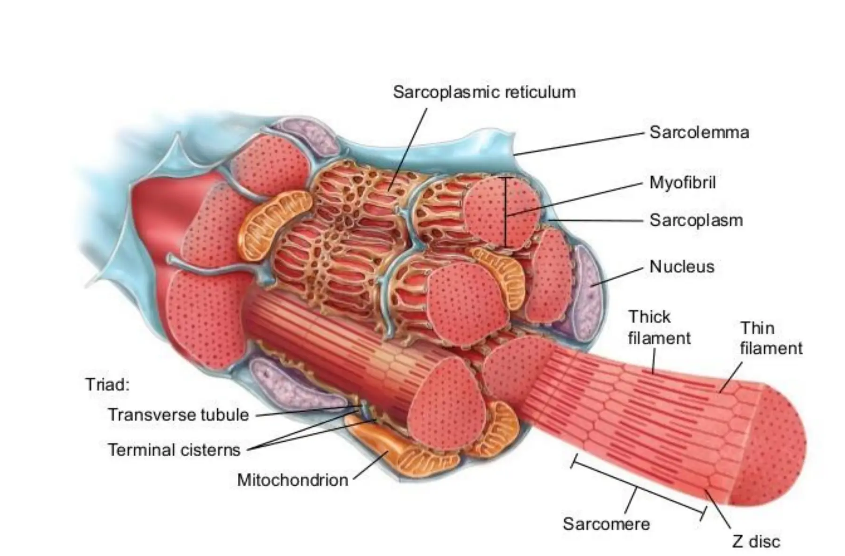

Slide 14
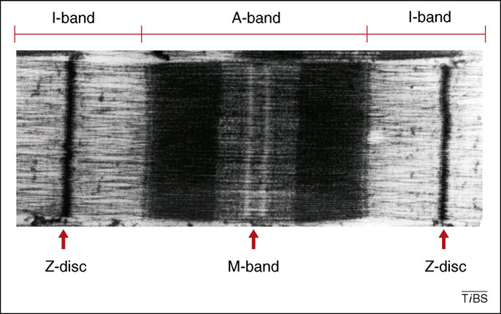

Slide 15
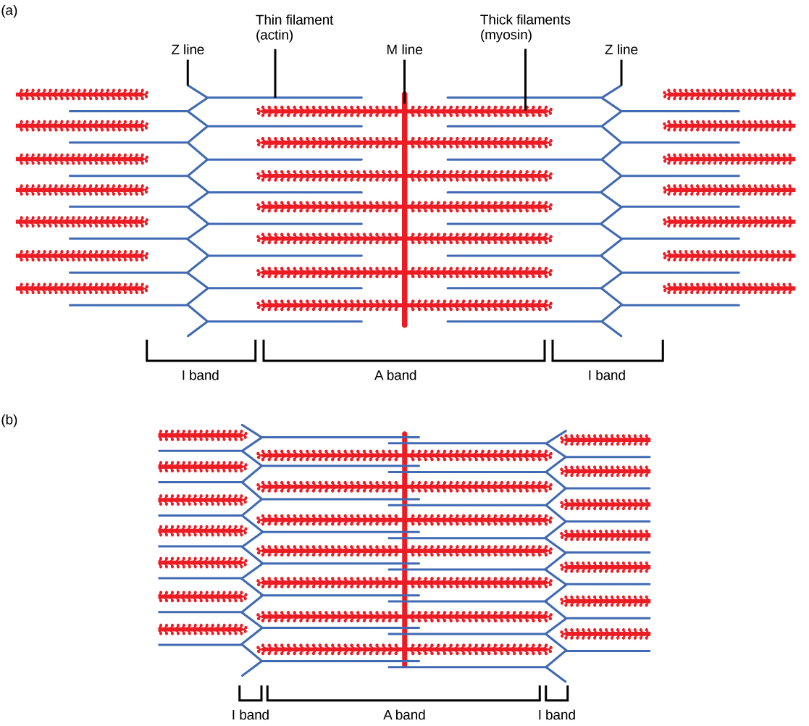

Slide 16
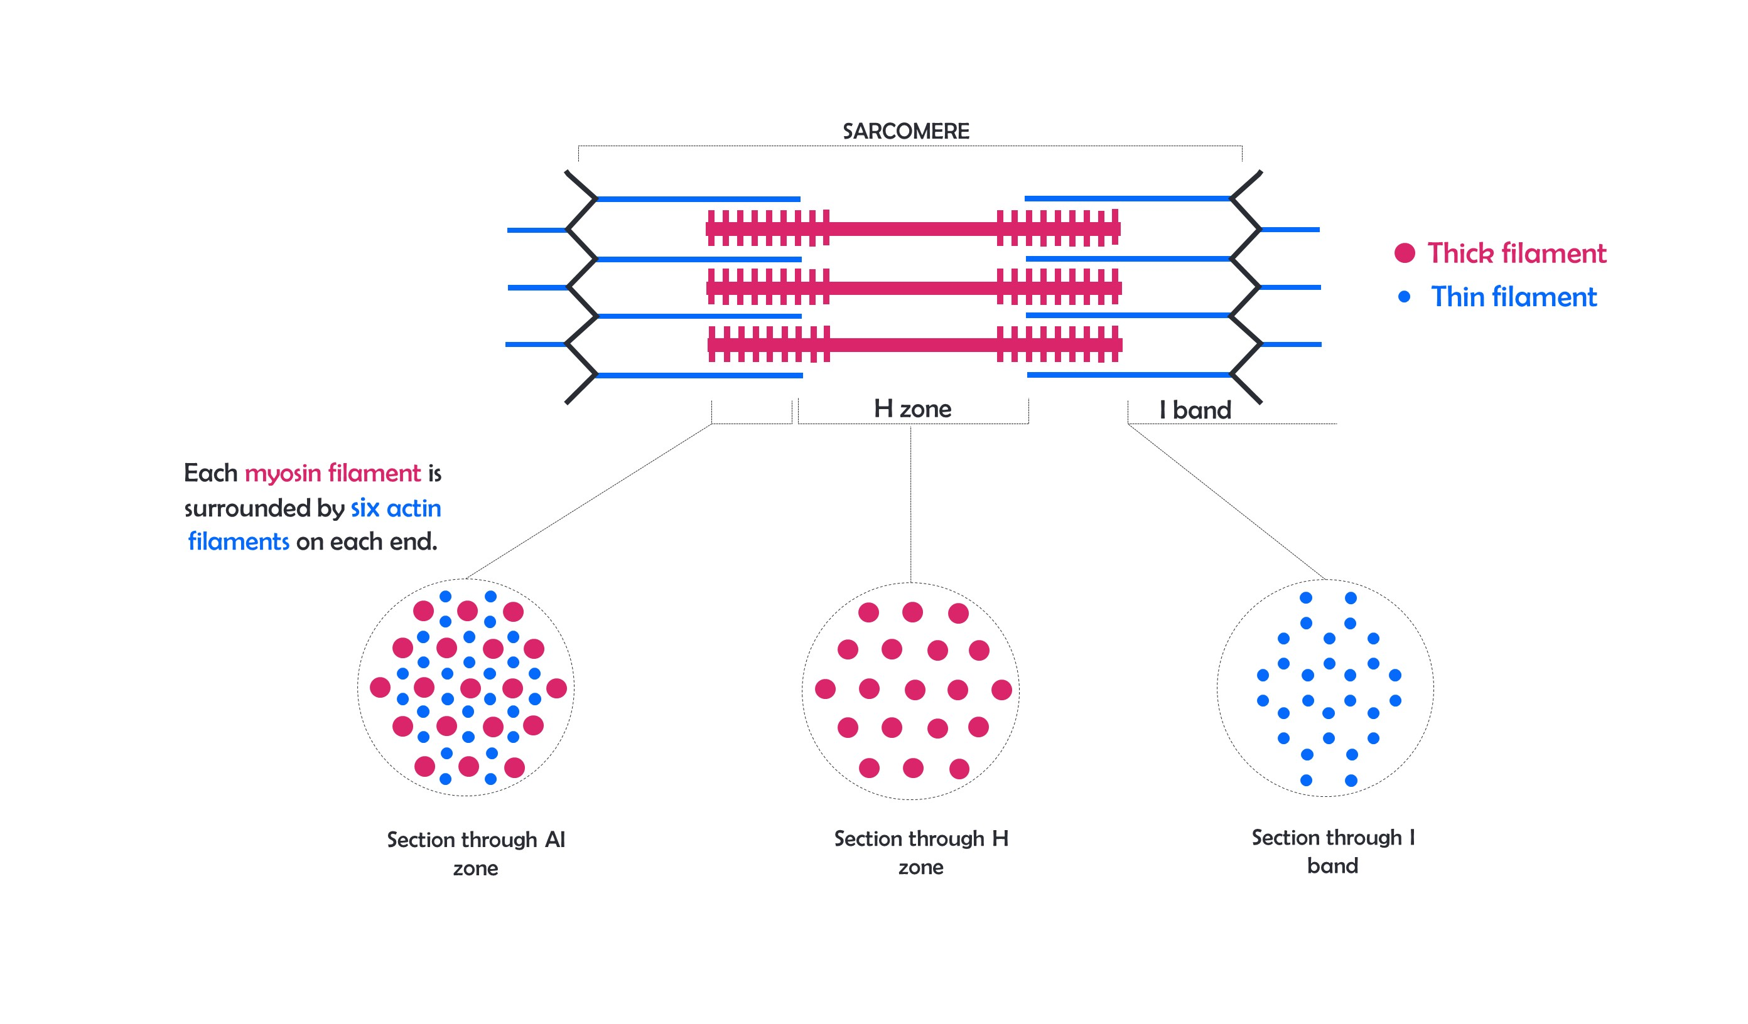

Slide 17
Structural proteins of Sarcomere and sarcolemma
Titin
Nebulin
Dystrophin

Slide 18
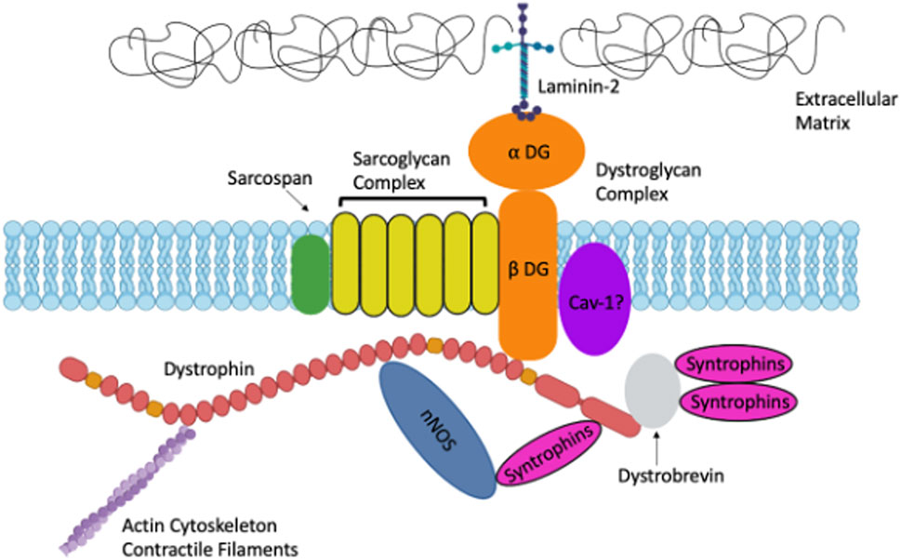

Slide 20
Protein | Main Connection / Function | In Simple Words
Dystrophin | Links actin (inside) to sarcolemma (cell membrane) and extracellular matrix | Acts like a shock absorber — keeps the membrane from tearing during contraction.
Nebulin | Runs along actin (thin filament) | Works like a ruler — sets and stabilizes the length of actin filaments.
Desmin | Connects adjacent myofibrils to each other and to the sarcolemma | Keeps all fibers aligned and coordinated — like ties holding rods together.
α-Actinin | Anchors actin filaments to the Z-line | The clamp that holds thin filaments at the Z-disc.
Myomesin | Cross-links myosin filaments at the M-line | The bridge that keeps thick filaments centered.
Titin | Connects Z-line to myosin along the sarcomere | Acts like a spring — provides elasticity and restores resting length.

Slide 21
Recent Advances

Slide 22
Gene editing (CRISPR, exon skipping): Restores partial dystrophin expression in muscular dystrophy.
Stem-cell therapy: Uses satellite or iPSC-derived myoblasts for muscle regeneration.
Advanced imaging: Super-resolution & MRI reveal sarcomere structure and fiber damage in vivo.
Proteomics: Maps titin, myosin, troponin modifications in fatigue and disease.
Bioengineered organoids: 3D-printed muscle models mimic real contraction for research.
AI modeling: Simulates sarcomere dynamics and predicts contractile performance.

Slide 23
MCQs

Slide 24
1. The basic contractile unit of skeletal muscle is:
a) Myofibril b) Sarcolemma c) Sarcomere d) Fascicle
Notes:
c

Slide 25
2. The thick filament of skeletal muscle is primarily composed of:
a) Myosin b) Actin c) Tropomyosin d) Troponin
Notes:
a

Slide 26
3. The thin filament is made up of:
Actin, tropomyosin, and troponin
Myosin and titin
Desmin and nebulin
Myosin only
Notes:
a

Slide 27
4. During muscle contraction, which band remains unchanged in length?
A-band
I-band
H-zone
Sarcomere
Notes:
a

Slide 28
5. The Z-line is formed mainly by the attachment of:
Actin filaments
Myosin filaments
Titin
Desmin
Notes:
a

Slide 29
6. Titin connects:
Z-line to myosin
Actin to sarcolemma
Myosin to actin
Troponin to tropomyosin
Notes:
a

Slide 30
7. Nebulin functions mainly to:
Regulate the length of actin filaments
Anchor myosin to Z-line
Bind troponin
Transmit nerve impulses
Notes:
a

Slide 31
8. Dystrophin provides linkage between:
Myosin and titin
Actin and the sarcolemma
Actin and troponin
Sarcoplasmic reticulum and sarcolemma
Notes:
b

Slide 32
9. Which protein connects adjacent myofibrils to maintain alignment?
Nebulin
Troponin
Titin
Desmin
Notes:
d

Slide 33
10. In Duchenne muscular dystrophy, which protein is defective or absent?
Dystrophin
Nebulin
Desmin
Titin
Notes:
a

Slide 34
Thank You

